Slide 1














Multilingual PDF RAG System
Presented by Saurabh Naik

Slide 2

Problem Statment
Develop a RAG pipeline for summarizing content and answering questions based on the input PDFs. The system should be scalable to handle large amounts of data (up to 1TB) and provide accurate, relevant responses.

Slide 3
01.
Architecture
PPT Contents
02.
Challenges Faced
03.
Future Enhancements

Slide 4
Chinese
Architecture
Bengali
LLamaParser
RAG Pipeline
Streamlit UI
Urdu
Vector Database
English
Multilingual-LLM

Slide 5
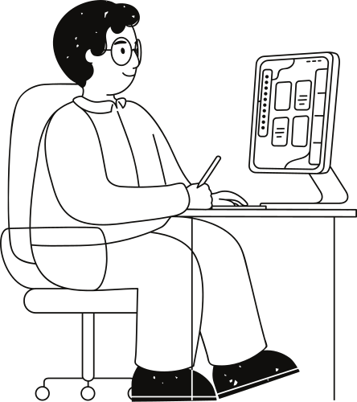
Challenges Faced
Document parsing for other languages than English
Unable to use Llamaindex with huggingface models
Unable to use gemini due to limit request
Hybrid Search/ Chunks with metadata was not done due to change in framework
Llamaindex provides function for agentic workiflow of Summary and QA

Slide 6
Future Enhancements
01
02
03
04
Check how to work with huggingface with LLamaindex
Graph QA can significantly improve results
Better Transformer models suitable multilingual text
Combination of GraphQA and Vector/Hybrid Search

Slide 7
Thank you very much!

